Slide 1
Cloud Computing

Slide 2
Topics
Erich: Intro, What is Cloud Computing?, Solving Problems
Ketim: Leading Companies, Main Models
Yonathan: Structure of the Cloud Environment, Structures of Data Centers
Anton: Creation of Virtual Machines, Reliability and Performance

Slide 3
Erich Berger
Intro to Cloud Computing

Slide 4

Let’s build a tech company!
I have a great idea for a company, it’ll revolutionize the way we read. It’s basically the Uber for books. It’s called “Librarie”.
I have a friend who’s good with computers, how hard can it be?
Notes:
I want to save money, so I'm going to do everything myself!
What that already exists? Well not like this it doesn’t!

Slide 5

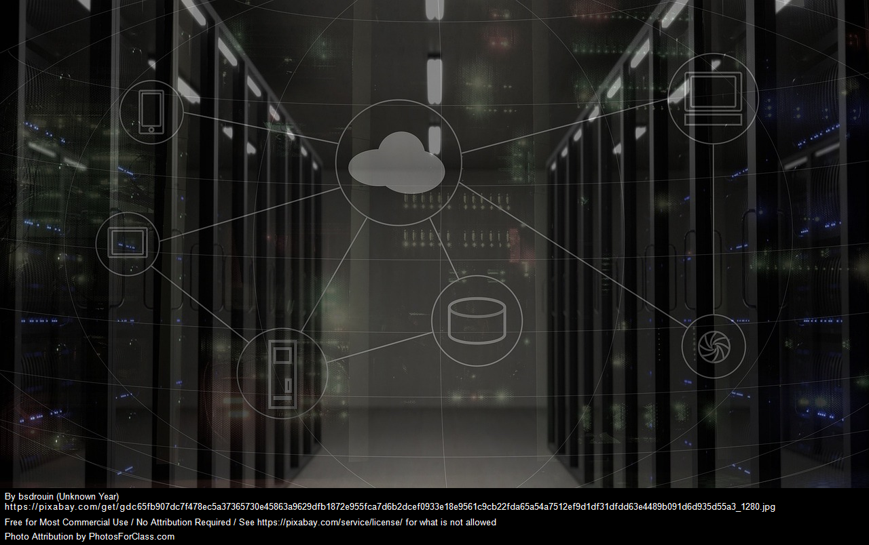


What do we need?
Security
Infrastructure
Maintenance
Staff
Notes:
Infrastructure: Servers, data storage, data backups, computer terminals, networking equipment, software, etc.You need some sort of physical space to store all of this.
Security: How to prevent outside intrusions? How to prevent data loss? Do you deal with sensitive information? How do you protect your IP?
Staff: All of the above needs people dedicated to building and maintaining the system, along with all of the other support roles that are needed to help them. People can be one of the most expensive resources a company uses.
Maintenance: What happens if things break? More people to be on call to help fix.Then pay to fix those things.

Slide 6

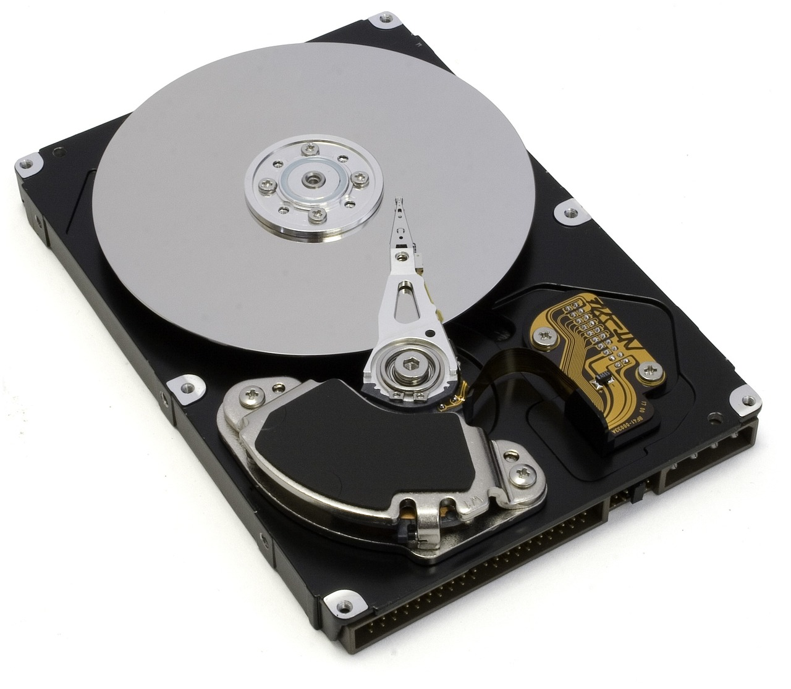
How about after all that?
More hardware?
Upgrades?
Data backups?
Notes:
Upgrades: Will eventually need to upgrade software, hardware. Repeat the building process over. What to do with old equipment?Transferring systems to new upgraded systems.
More Hardware: as the company grows, user base grows, more infrastructure to help deal with the increase in demand: more money!
If something happens, we want to make sure we can get back and running without losing revenue stream.

Slide 7


Two big things:
On second thought…
But wait!
Cloud Computing is here to help!
Notes:
All of these fall under the categories of time and money, which are the major considerations of any business. How long will it take to make the product before it's profitable, and how much do I need to invest in the product?
That’s where cloud computing comes in!

Slide 8
What is cloud computing?

Slide 9
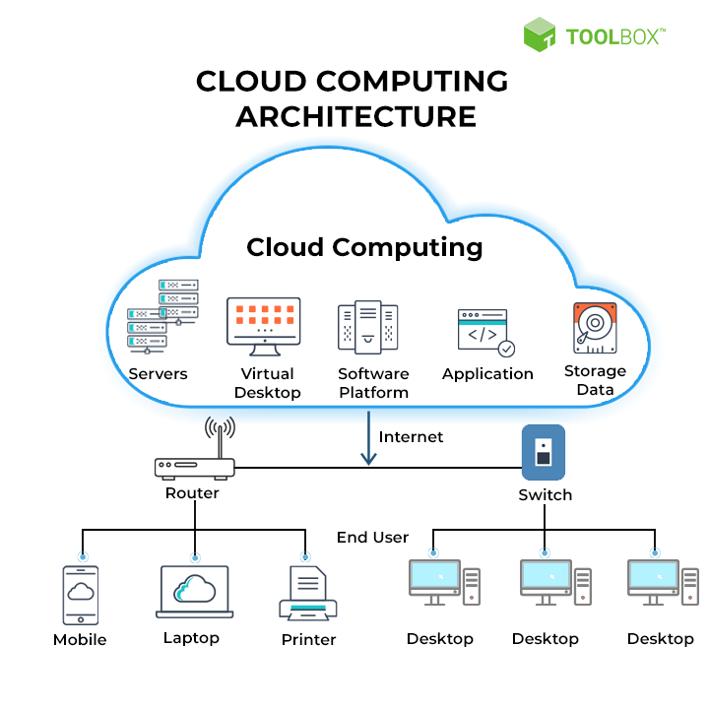
Simple Definition:
Data, resources, and applications that are run and stored on remote resources, accessed over the internet
Notes:
This image gives a pretty general representation of the cloud. It shows different levels of computer resources being "in the cloud" and connecting those resources with users over the internet.
Sharing computing power.

Slide 10
Brief History
IBM, Universities teamed up for huge research computer farms
Netflix starts streaming
Project MAC: multiple people using a computer from various locations
COVID makes the world move more online, rapidly increases need for services
Amazon does retail online
1963
2002
2007
2020+
1999
2006
2012
Salesforce sends software over internet
Launch of AWS, Google Docs
Oracle Cloud offers Iaas, Paas, Saas options

Slide 11
A bit more…
Cloud computing companies provide computers as a service you pay for
Instead of using your own computer to perform tasks, you pay those companies to use theirs
Companies are able to split up a computer’s resources so multiple people can use it
Workload is on the company’s computer
Different levels and kinds of computing resources are available
Just infrastructure?
Infrastructure and a platform/OS?
One specific application?
A database?
Notes:
Computing as a service. Just like going to a movie, or getting a haircut, or legal advice on how not to get sued by book publishers...
You don't need to own the computing resources in order to use computing resources
The big cloud computing companies portion out there computers for different purposes.
Ketim will talk more about the levels of cloud computing when he goes over models. There are a bunch of different needs when it comes to computing: do you need storage? somewhere to build an app? Do you just need the computing power to run your own system?
Cloud computing is flexible!

Slide 12
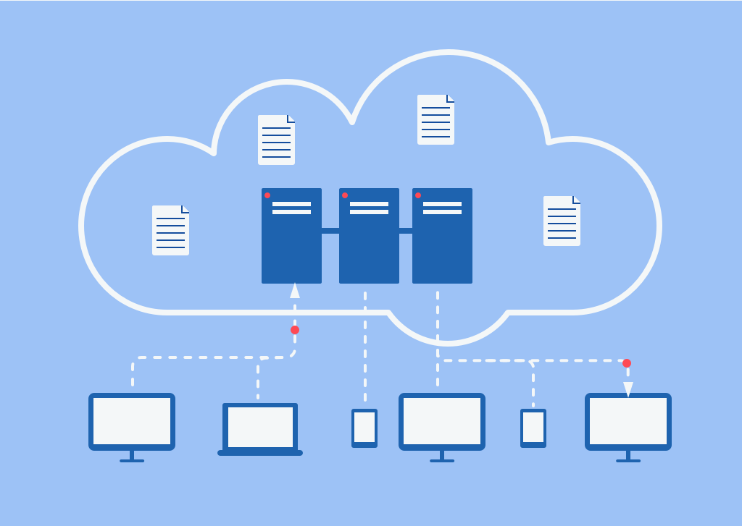
How does it work?
The Cloud is a familiar concept:
Data is stored on servers, and accessed over the internet.
Well, applications are really just collections of data, so could they use the cloud? How about entire operating systems? Maybe even… computers?
Notes:
Let’s break this down into two main concepts:
You're probably somewhat familiar with the cloud in some capacity.
Something is stored, and is sent to you, and sent back.

Slide 13
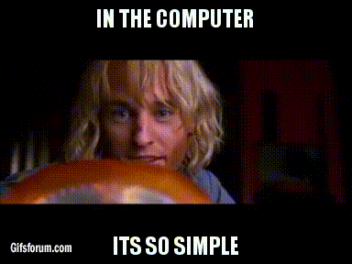
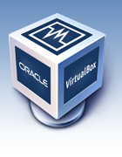
Virtualization
Creating a virtual computer inside another computer
A system that is running on your OS
The Virtual Machine doesn’t know it’s not running on dedicated hardware
Allocate resources to the VM
You might be familiar with this already:
A computer
Notes:
virtual: a simulated creation
An easy way to think of this is when you want to run a different OS on your computer.
Virtual Machine: simulated computer, not connected directly to hardware. It's essentially a walled garden
You decide what resources you want your computer to pass on to the VM. We'll talk more in a bit about how that works.
If you've ever used virtual box, or some other program to run a system.

Slide 14
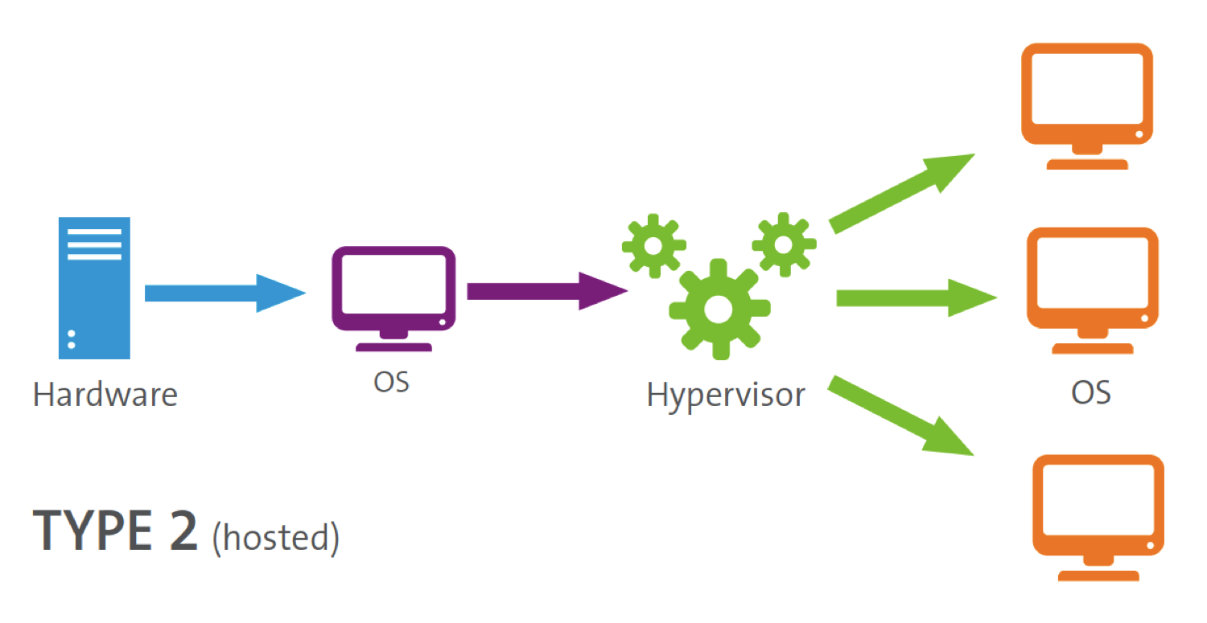
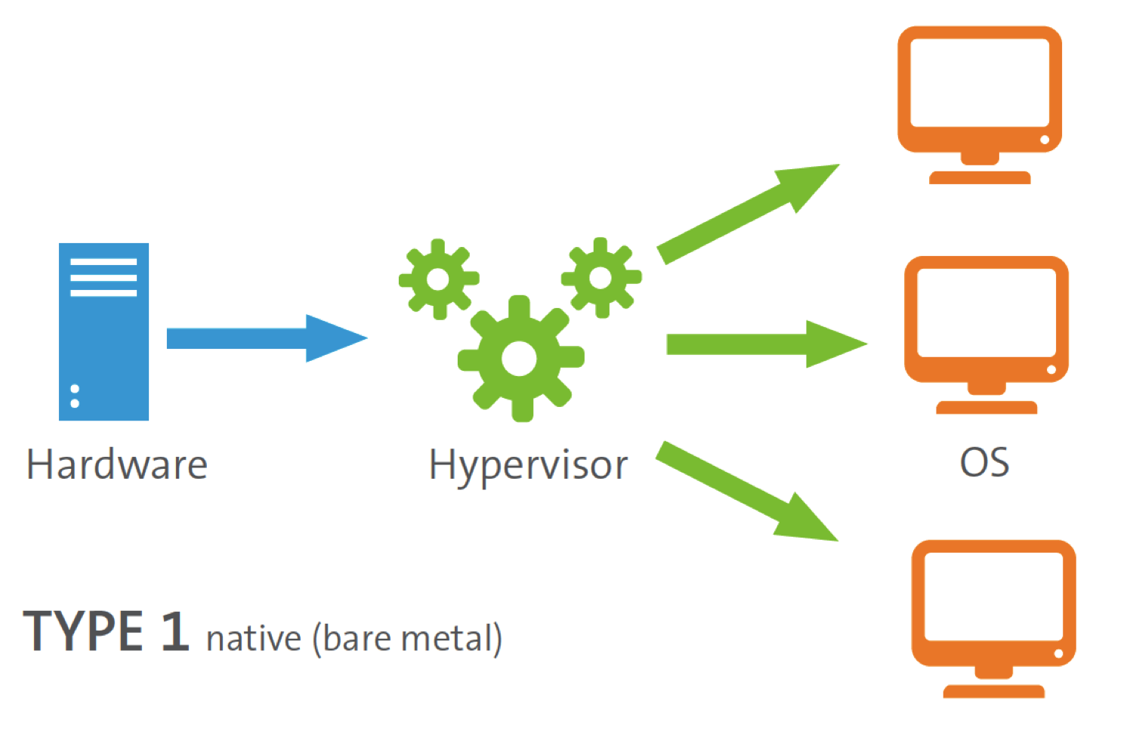
Hypervisor
Software that creates and regulates the VM
Acts as an intermediary between OS and VM (or hardware and VM)
Large companies use Type 1
Notes:
In the previous slide, Virutal Box is an example of a hypervisor.
Starting from the base, you have your computer, which runs an OS. On the OS, you have a hypervisor (like virtual box), which then is able to create Virtual Machines.
That's how it works for individual users. For large scale companies, they'll often omit the OS layer, and build the hypervisor directly on the hardware.

Slide 15
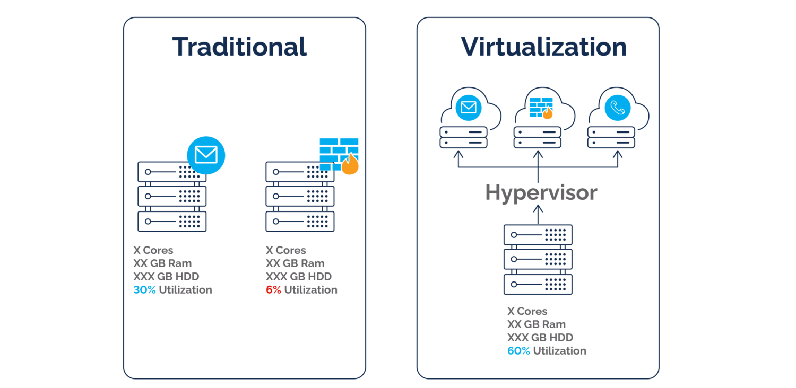
More on Virtualization
Allows computers to act as more than one virtual machine (server, OS, etc.)
Allows renting out access to a portion of a computer’s resources
More efficient use of a computer’s resources
Side Note: Terminology
Containers and VMs are both examples of virtualization. VMs include OS and software, containers include software, but not the OS.
Notes:
One computer can essentially run many computers on itself, each with a different purpose. These can be rented out as a portion of a computer's resources, as they have no idea that the other VMs are also running on the computer.
When you have computers that are dedicated to a single purpose, like a server, it's likely not all its power is being utilized. This is pretty inefficient, especially if you're the one buying the computers. No waste!

Slide 16
What problems can be solved with cloud computing?

Slide 17
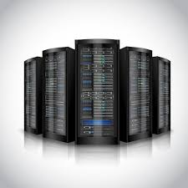

Reduces Infrastructure Cost
Traditional Computing | Cloud Computing
Huge upfront cost | Pay only what you need (computing as a service)
Hire staff to support infrastructure | Staff rolled in with cost
Pay for all levels of infrastructure | Pay only for levels that you need

Slide 18
Reduces Time to Market
Traditional Computing | Cloud Computing
Spend time on infrastructure | Near immediate access
Spend time hiring, training | Staff rolled in with cost
Notes:
Near immediate access: still need to setup the access, there is always some initial time required to get the service matched to the expectations.

Slide 19
Enables Scaling
Traditional Computing | Cloud Computing
With growth, buy more infrastructure | Easy to rent more

Slide 20

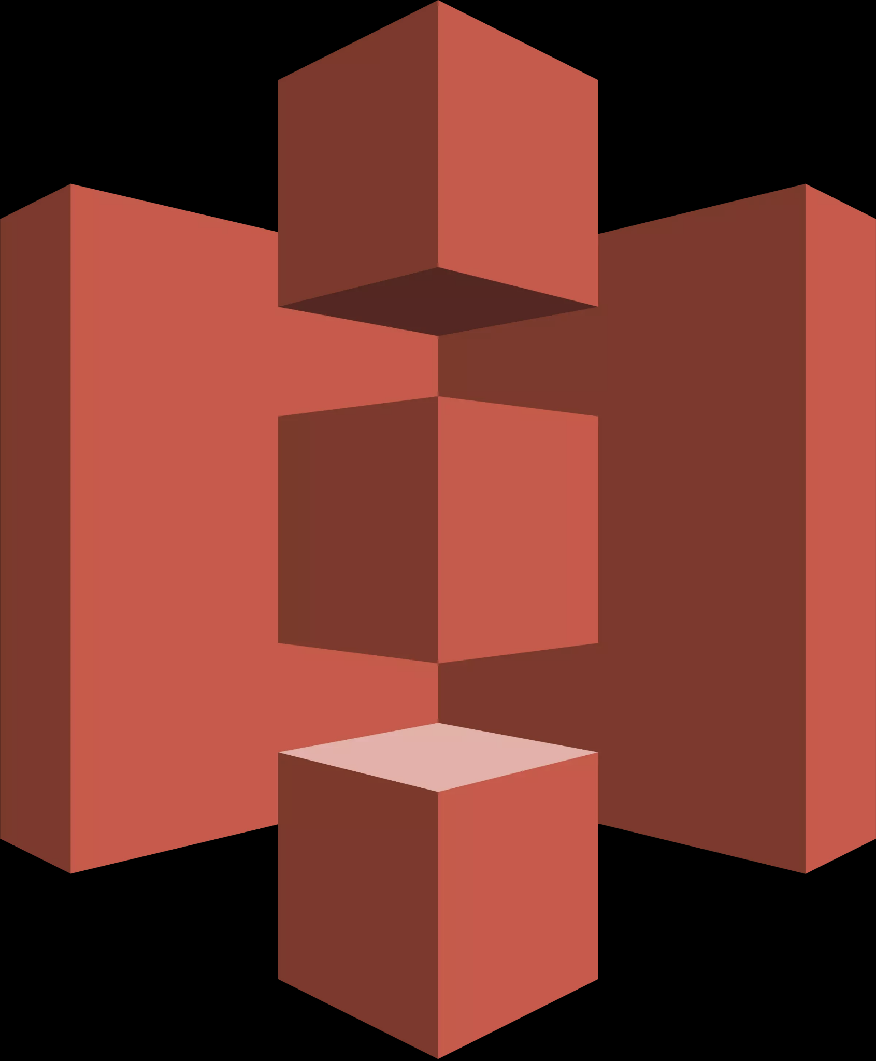

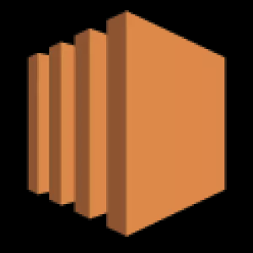
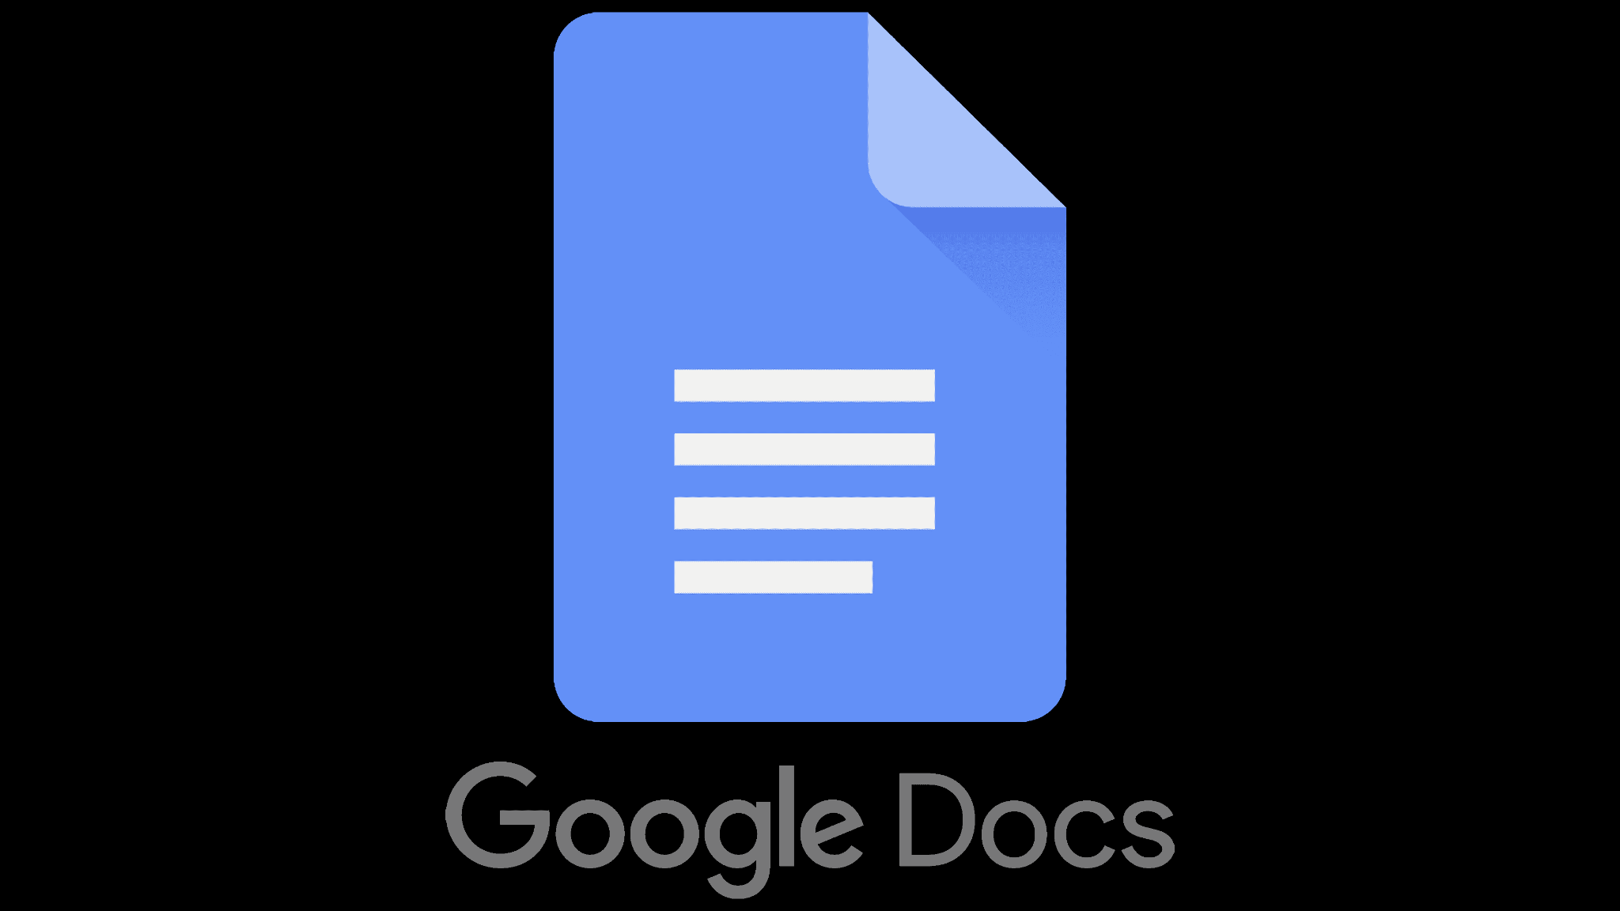
Focus Only On Infrastructure You Want
Traditional Computing | Cloud Computing
Buy everything | Specify if you want only computing resources, a platform, software, etc.
Lightsail: developer environment
S3: data storage
S3 Glacier: archival
EC2: virtual servers
Notes:
AWS provides many different products and services depending on what the client needs.
Developer environments, web app manager, database managers by type, security, cloud monitoring, data storage in various forms, etc.
As we mentioned before, cloud computing is flexible!!

Slide 21
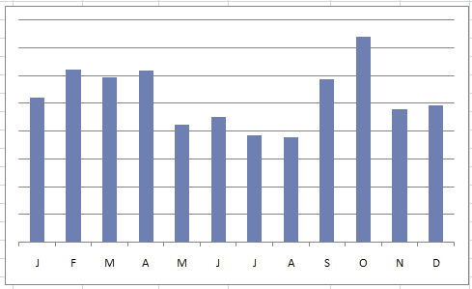
Deals with Fluctuations of Use
Traditional Computing | Cloud Computing
Stuck with what you’ve purchased | Modify what you pay for
Notes:
Demand on any system and the resources it uses will never be constant. There will be times where you need a lot of power, or sudden dips where almost none is required. Because cloud computing can be pay for what you need, this reduces the amount of money spent on computing power.

Slide 22

Increases Security
Traditional Computing | Cloud Computing
You are responsible if things go wrong | Company is responsible for security of services provided
Notes:
These large companies have dedicated security staff to oversee their services. They have it already in place, and they have experience dealing with all sorts of threats. Trying to do your own security, unless you spend a lot on it, may not be quite as good.

Slide 23
Ketim Lamessa
Companies and Models

Slide 24
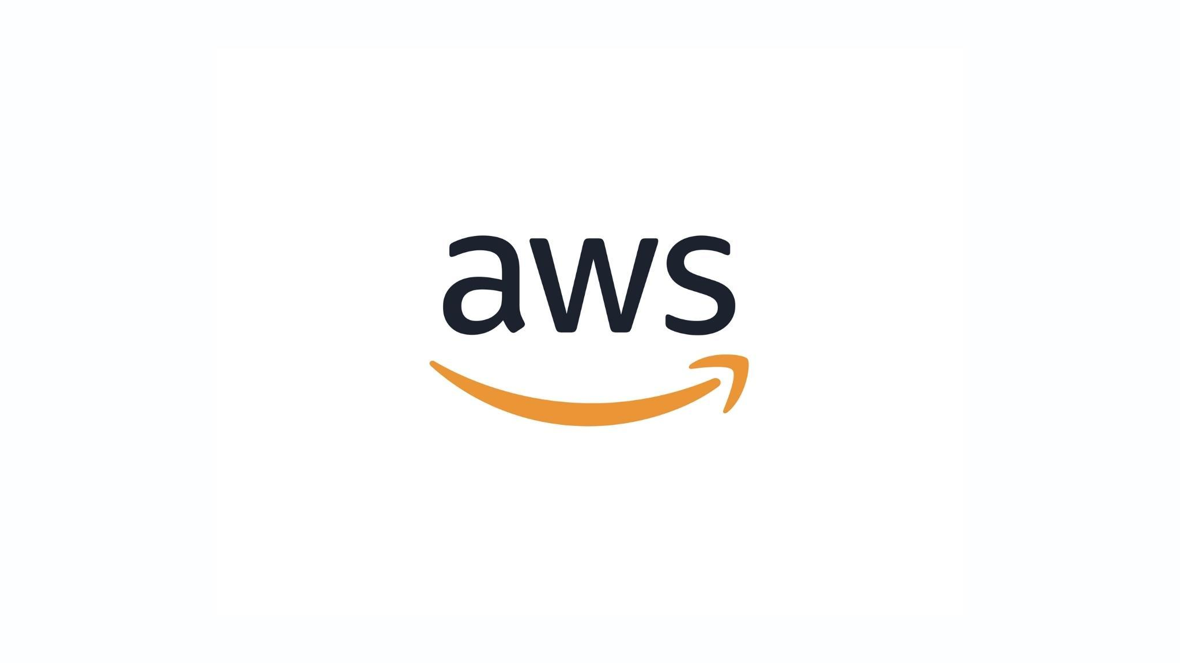

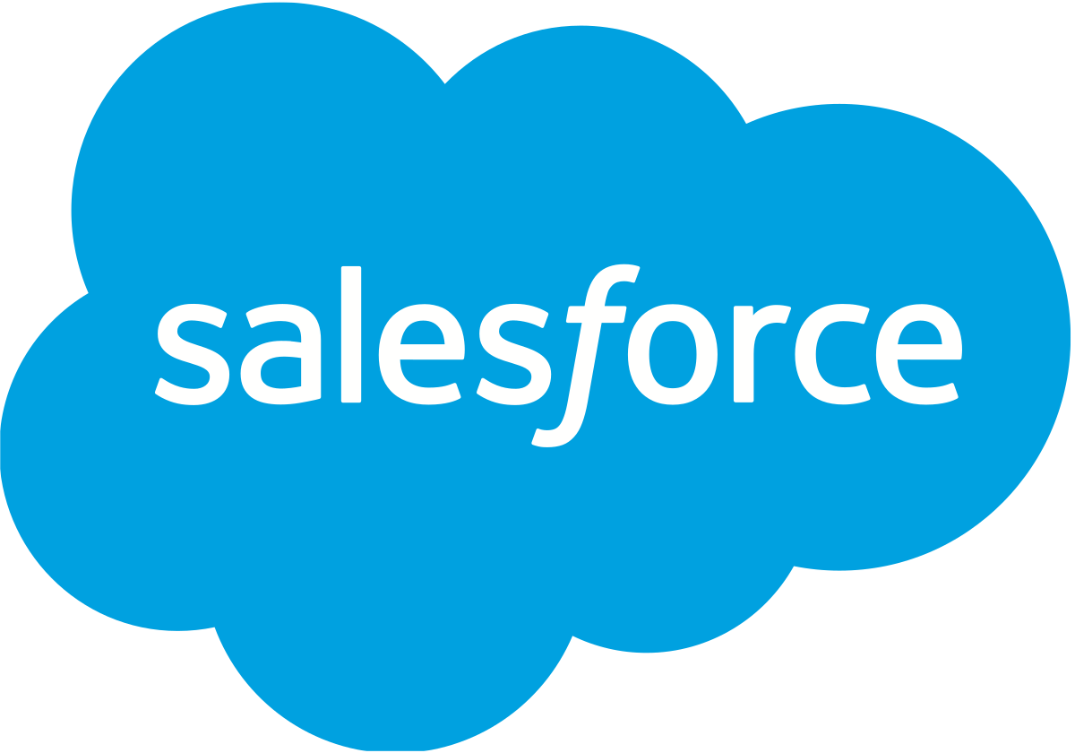

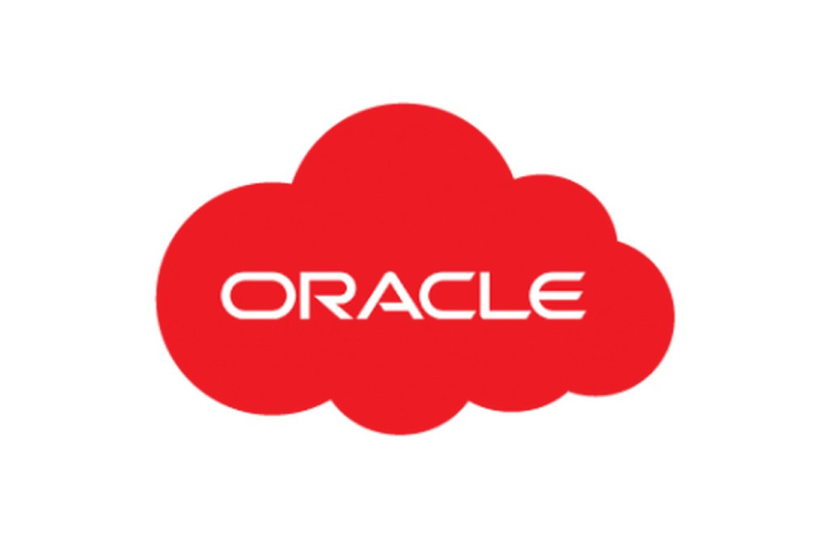
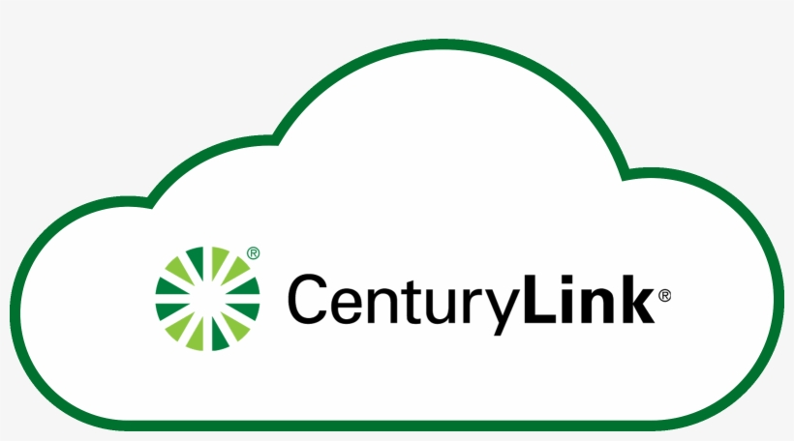
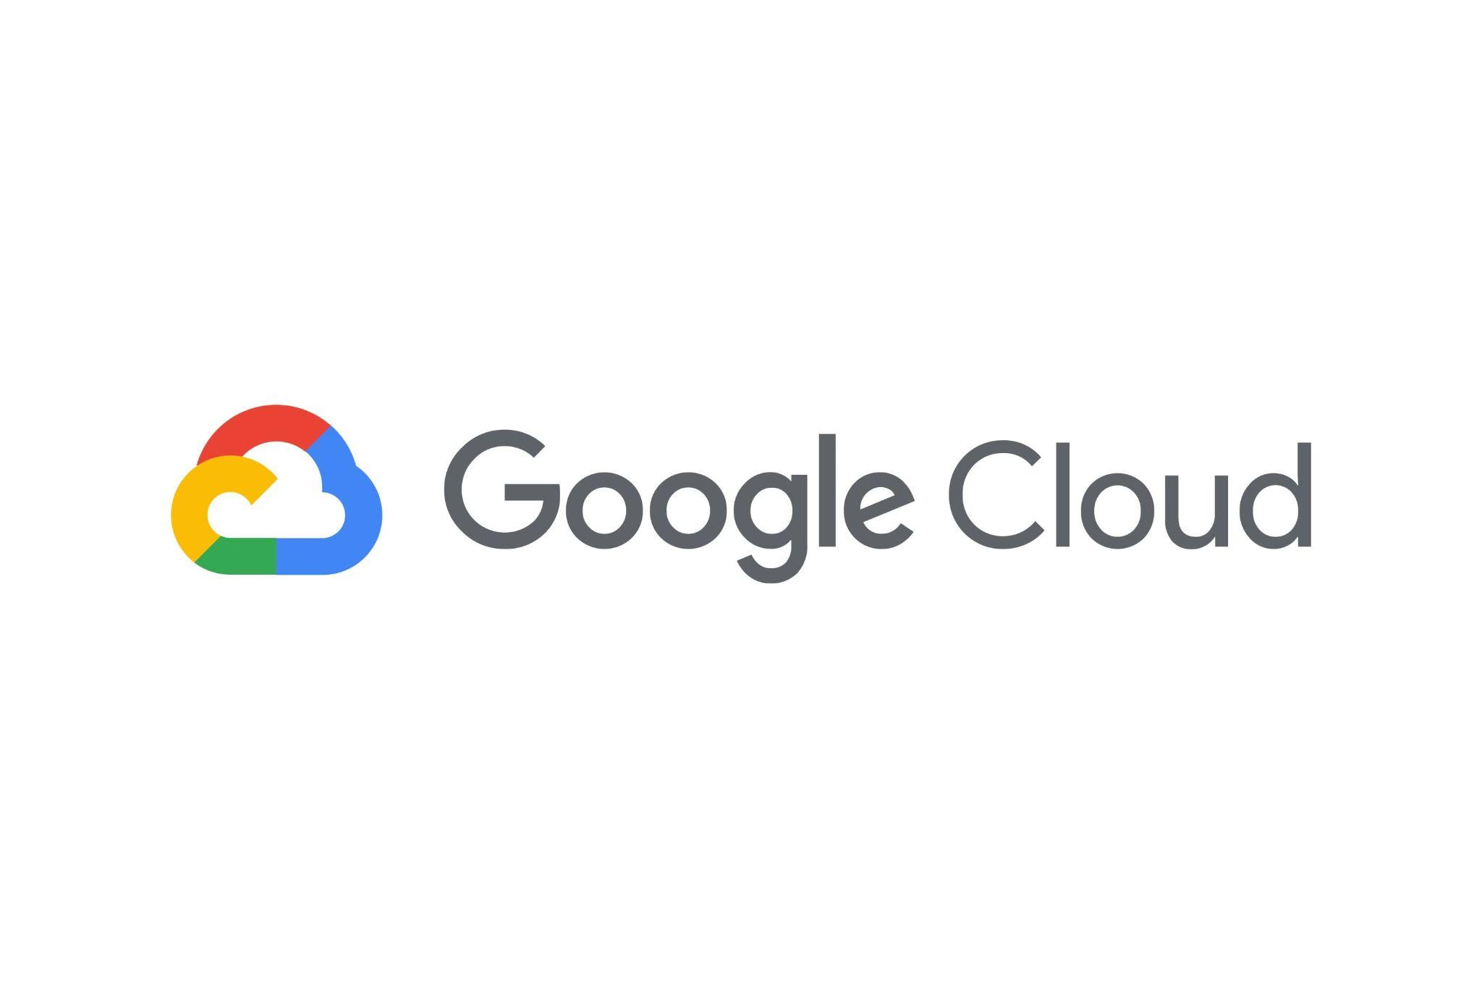
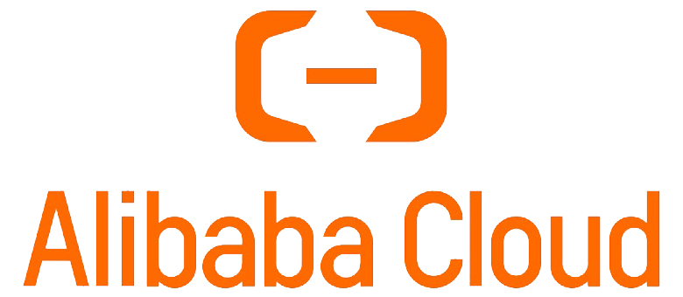

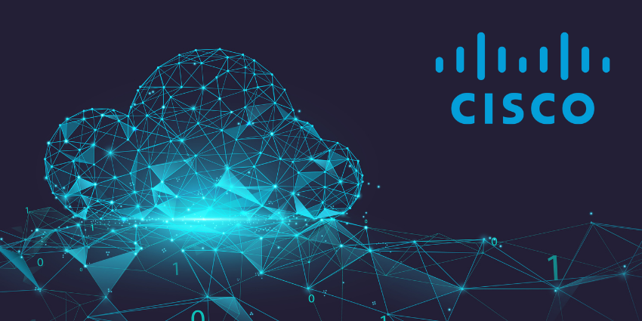
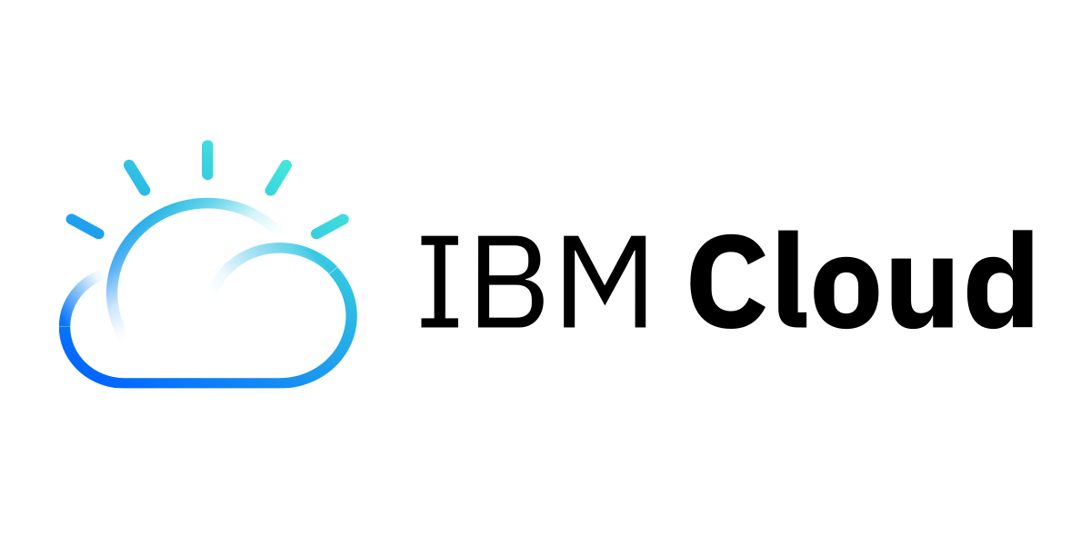

Who is doing cloud computing?

Slide 25
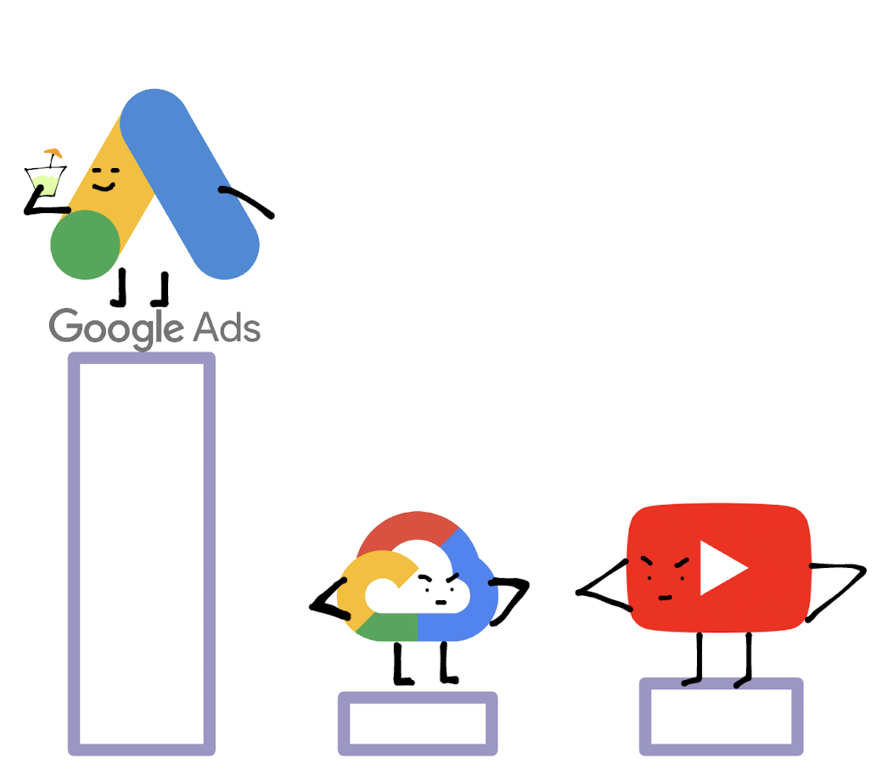

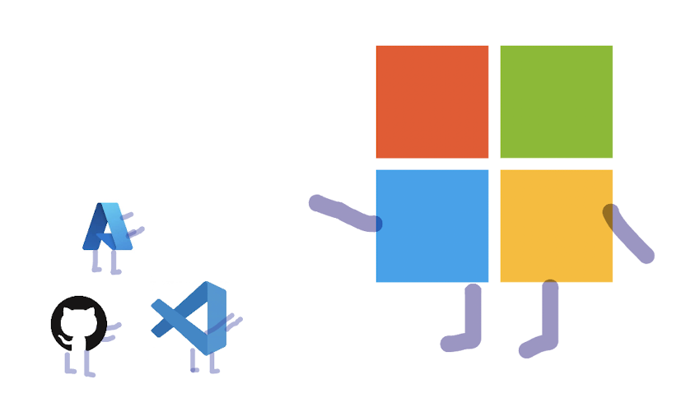
These are highly profitable companies….
“Significant” contributor of Amazon’s profits
Google Cloud
matches YouTube
in profitability
A majority of Microsoft’s profitability is from its cloud services
How is cloud providing value?

Slide 26
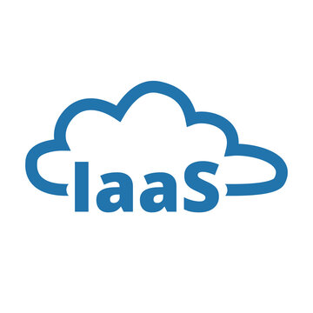

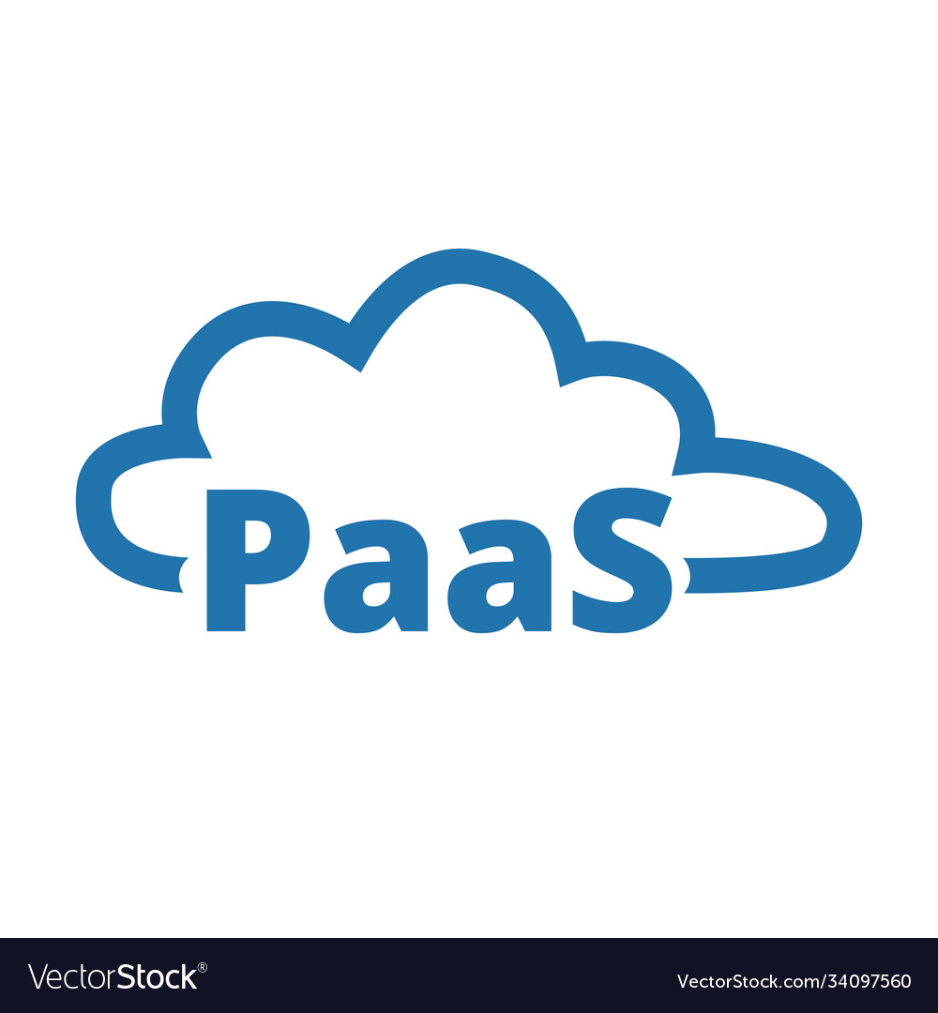
Different Models for Different needs
Cloud Computing Models

Slide 27



Infrastructure as a Service
Provides virtualized computing resources over the internet like virtual machines, storage, and networking infrastructure.
Allows users to access and manage scalable infrastructure without the need for physical hardware.
Provides more control and flexibility compared to PaaS and SaaS, allowing users to manage the operating systems, applications, and data.
Amazon EC2 for scalable computing (Aws) and S3 for storage.
Companies like Netflix and Airbnb rely on AWS for their infrastructure needs.

Slide 28

Platform as a service
Provides a development and deployment platform for creating and managing applications without worrying about the underlying infrastructure.
Simplifies application development, developers can focus on coding their applications without managing infrastructure.
Removes the complexity of infrastructure management -> ready-to-use platform
Heroku is PaaS provider known for its simplicity and developer-friendly environment
Companies like GitHub and Lyft use Heroku for hosting and managing their applications

Slide 29

Software as a Service
Delivers software applications over the internet via subscription, eliminating the need for installation and maintenance.
SaaS allows users to access and use software applications from anywhere, anytime, without worrying about infrastructure or software updates.
SaaS provides complete software solutions, and users only need a web browser or dedicated client application to access and utilize the software.
Salesforce: Salesforce offers a popular SaaS CRM (Customer Relationship Management) platform.
Companies use Salesforce for managing customer interactions, sales processes, and marketing campaigns.

Slide 30
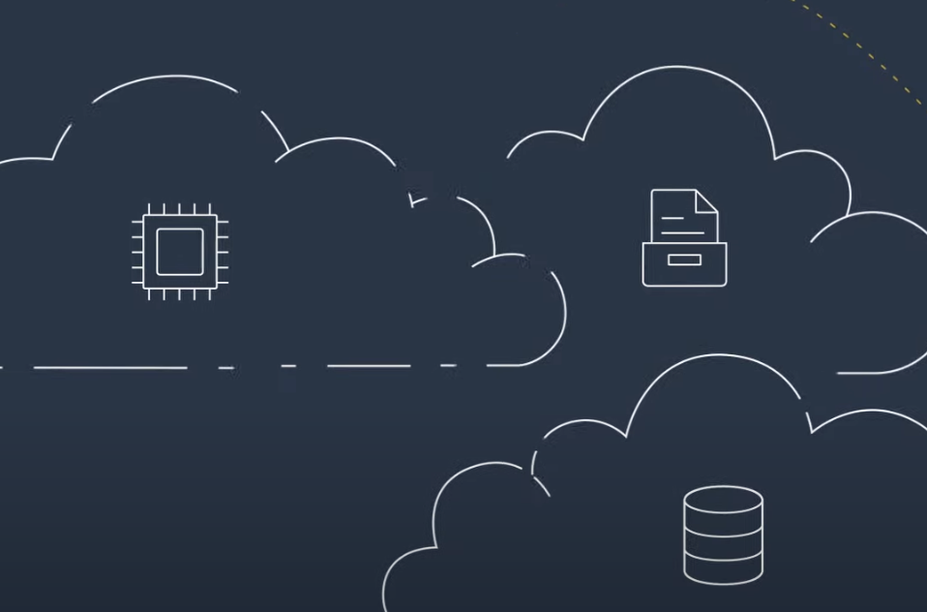
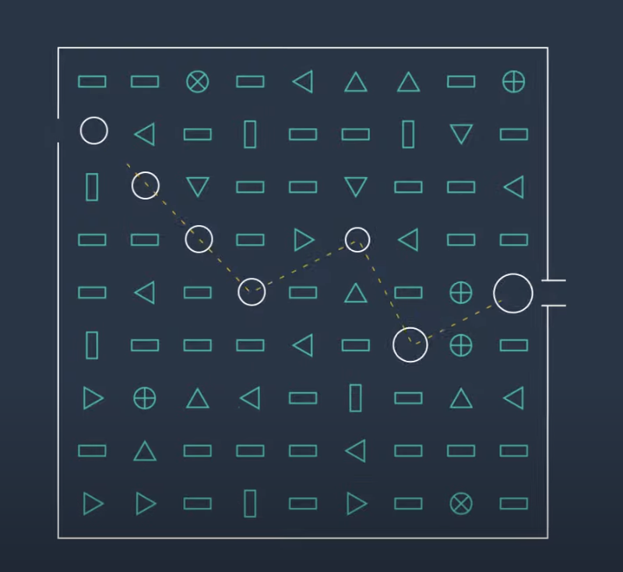
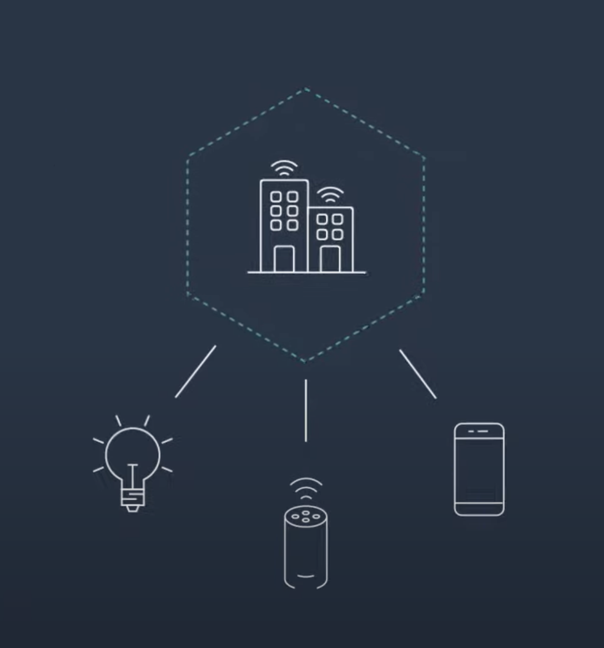
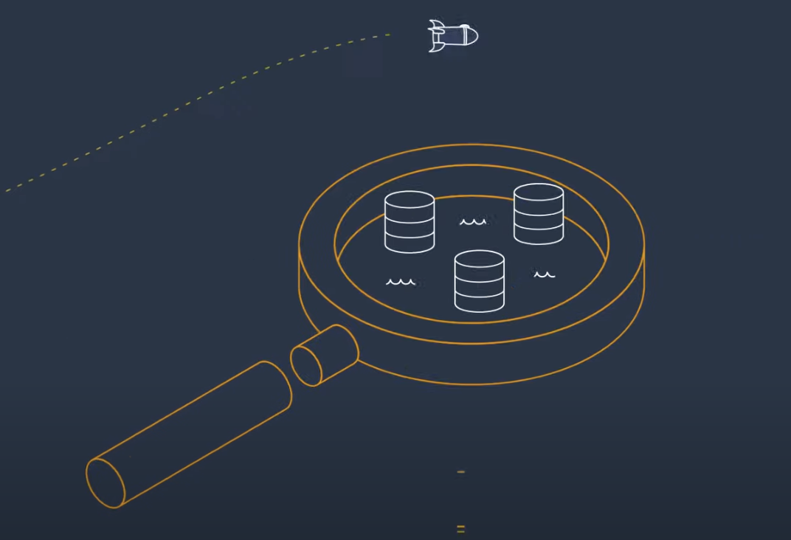
Looking back at AWS…
Amazon's AWS platform encompasses all three cloud computing models, making it a convenient solution for businesses.
By providing services for IaaS, PaaS, and hosting SaaS solutions through the marketplace, AWS caters to a wide range of cloud computing needs.
This versatility contributes to Amazon's position as one of the most profitable cloud services providers and controls a third of the market of internet!
Infrastructure Tech
Emerging Tech (AI & ML)
IoT
Data & Analytics

Slide 31
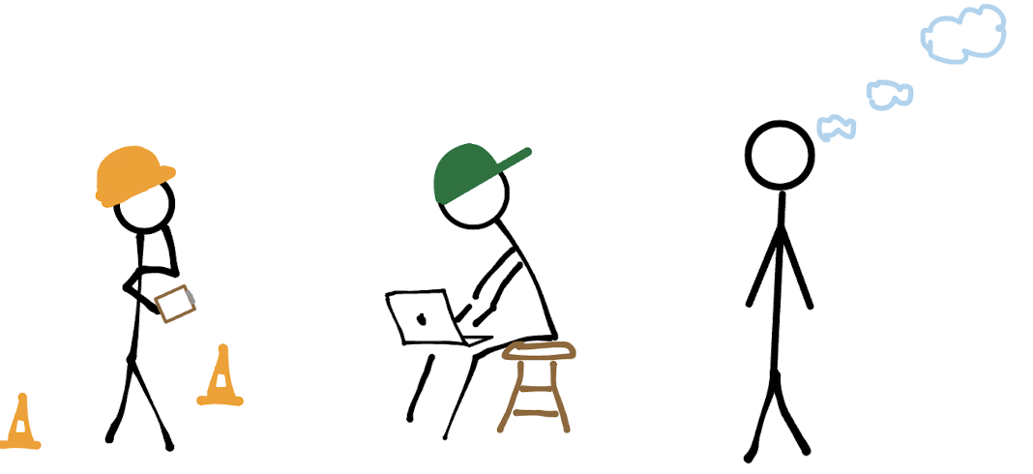
If you were a tech company….

Slide 32
Yonathan Maruani
Cloud Environment and Data Centers

Slide 33
Describe in detail how a cloud computing environment is structured?
3
By: Yonathan Maruani

Slide 34

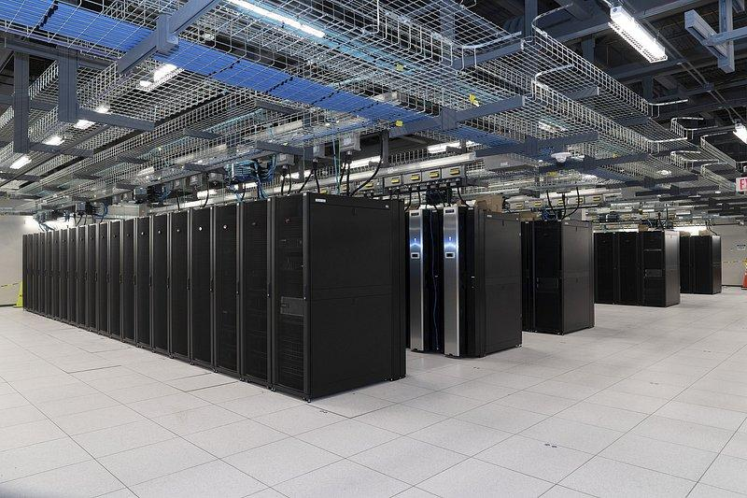

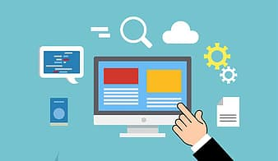

Cloud computing environment structure
Front End
Back End
Network
Middleware
Security & Management

Slide 35

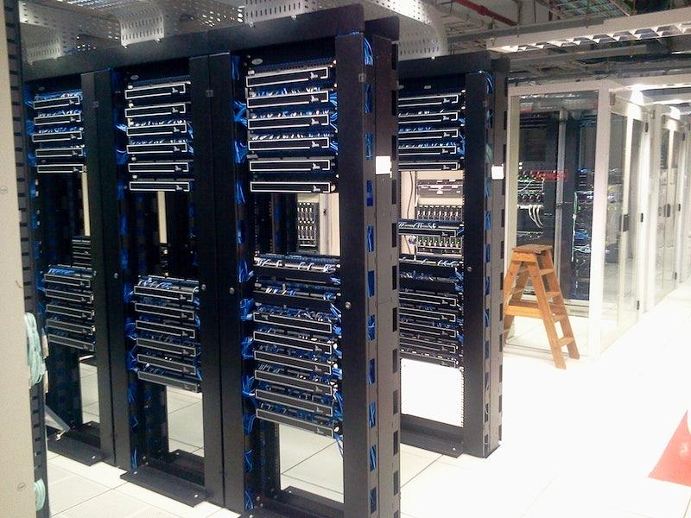

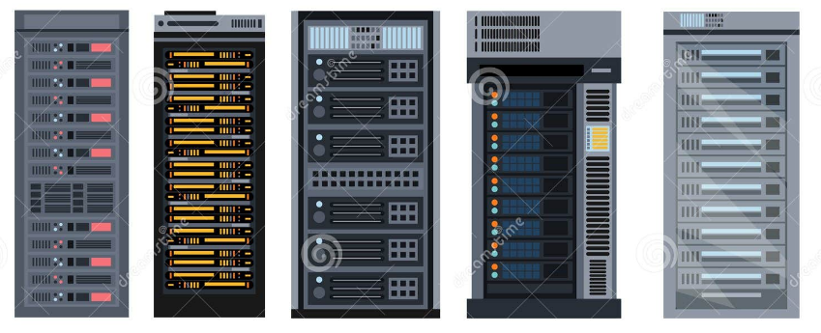
Middleware
Network
Front End
Back End
Compute servers
Storage servers
Databaser servers
Application srvs
Web servers
Mail servers
Network servers
Backup servers
Load balancer srvrs
Authent. servers

Slide 36
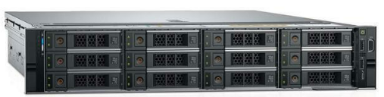
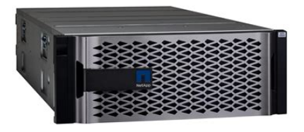
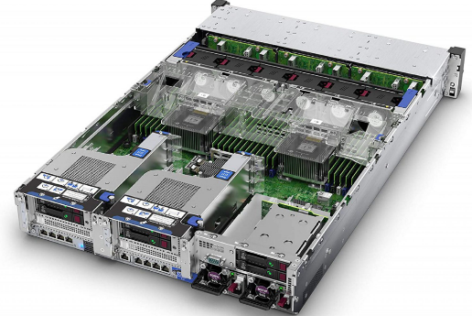
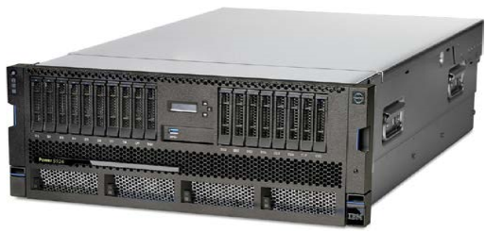
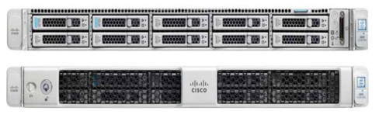
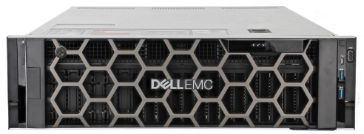
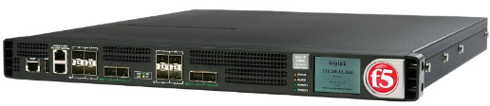
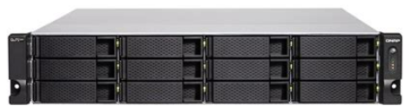
Types of servers - Back End
Compute server
Dell PowerEdge R740xd
Storage server
NetApp AFF A800
Mail server
IBM Power System S914
Database / Web / Authent. server
HPE ProLiant DL380 Gen10
Network server
Cisco UCS C220 M5
Application server
Dell PowerEdge R940
Remember that the actual server hardware is often less important than the software running on it.
Load balancer server
F5 BIG-IP iSeries
Backup server
QNAP TS-2888X

Slide 37
Middleware (Software)
Middleware is the software that connects the front end (client-side user interface) to the back end (servers, databases, etc.), allowing them to communicate and exchange data. It can handle tasks like message queues, application servers, web servers, databases, and more.
Here are some examples of middleware:
Web Application Frameworks: These frameworks often act as middleware. They provide tools and libraries that simplify common web development tasks, including routing, session management, and user authentication. Examples include Express.js for Node.js, Flask and Django for Python, and Ruby on Rails for Ruby.
API Gateways: An API gateway is a server that acts as an API front-end, receives API requests, and enforces throttling and security policies. It then routes requests to the appropriate microservice. Kong and Apigee are examples of API gateways.
Message Brokers: Message brokers help in exchanging data between front-end and back-end systems by translating the language of one system into another. Examples include RabbitMQ, Apache Kafka, and ActiveMQ.
Caching Systems: These can act as a middleware to cache data from the back-end server and quickly serve it to the front end when needed, improving the performance of web applications. Examples include Memcached and Redis.
Authentication Middleware: These handle all aspects of user authentication, from verifying user credentials to managing user sessions. OAuth and JWT (JSON Web Tokens) are popular formats for sending information between parties in a way that can be trusted and verified.

Slide 38
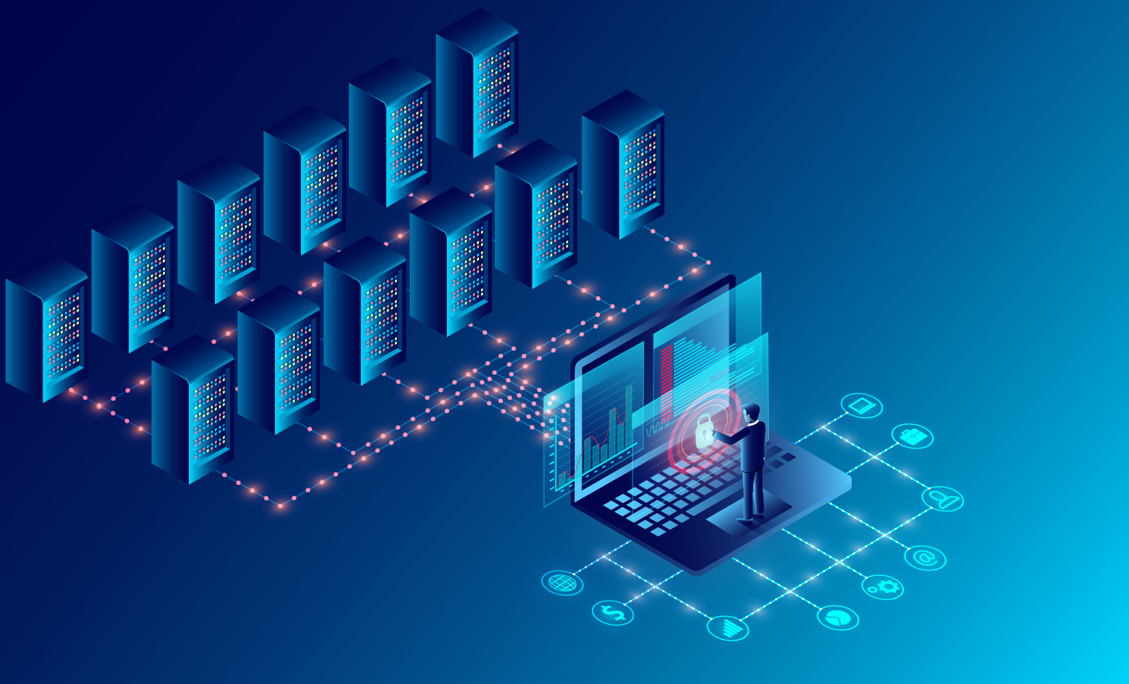
Security
Cloud environments typically have robust security measures in place. This includes firewalls, intrusion detection systems, data encryption, multi-factor authentication, and identity and access management (IAM) systems. These measures aim to prevent unauthorized data access and ensure data privacy and integrity. Cloud providers follow stringent security standards to maintain the trust of their customers.

Slide 39
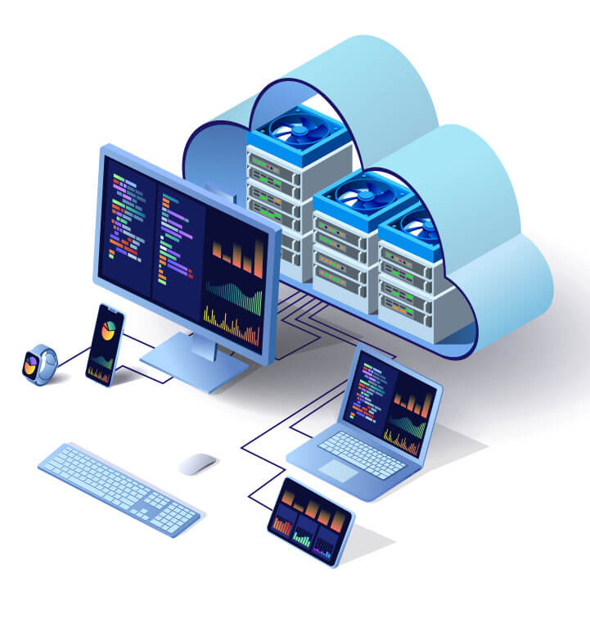
Management Software
Cloud environments are complex and require sophisticated management tools to monitor and control the various resources effectively. These tools provide features like resource provisioning and de-provisioning, monitoring and logging services, billing and account management, load balancing, and auto-scaling. They help users manage their cloud environments efficiently and enable them to make the best use of the available resources.

Slide 40
How are the data centers structured and where are they located?
3

Slide 41
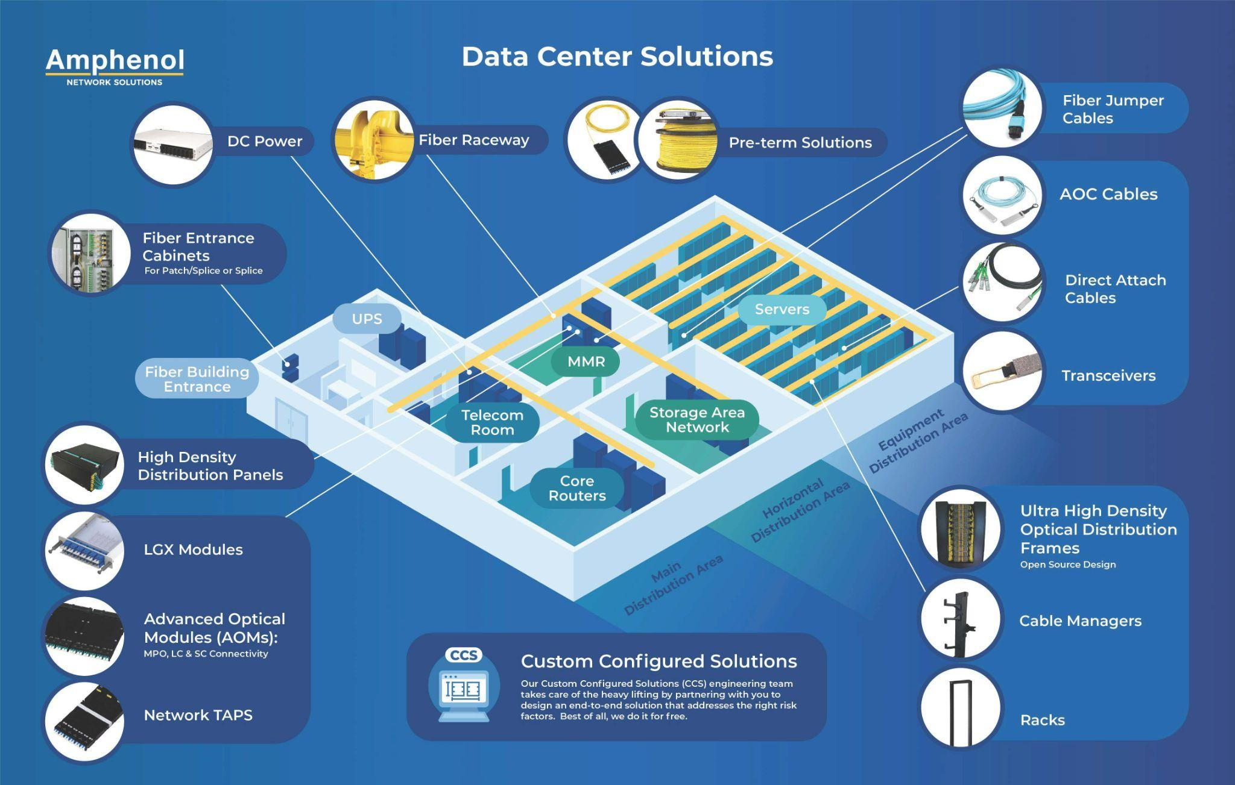
Data Centers Structure

Slide 42
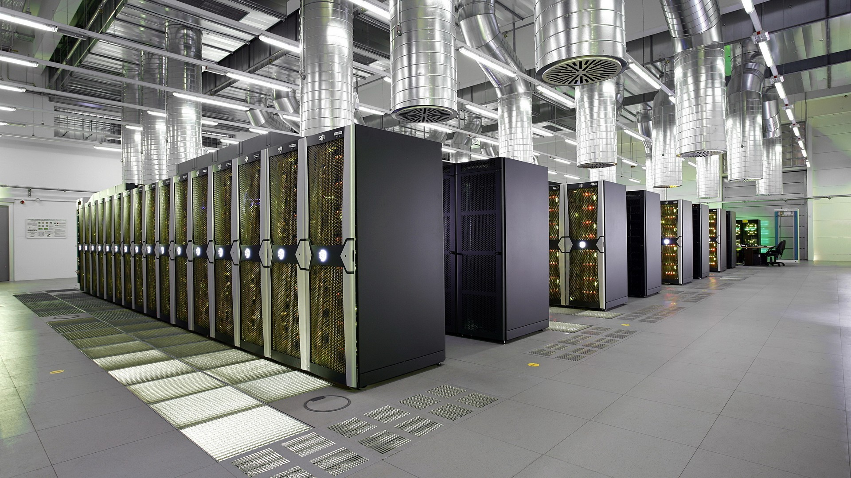
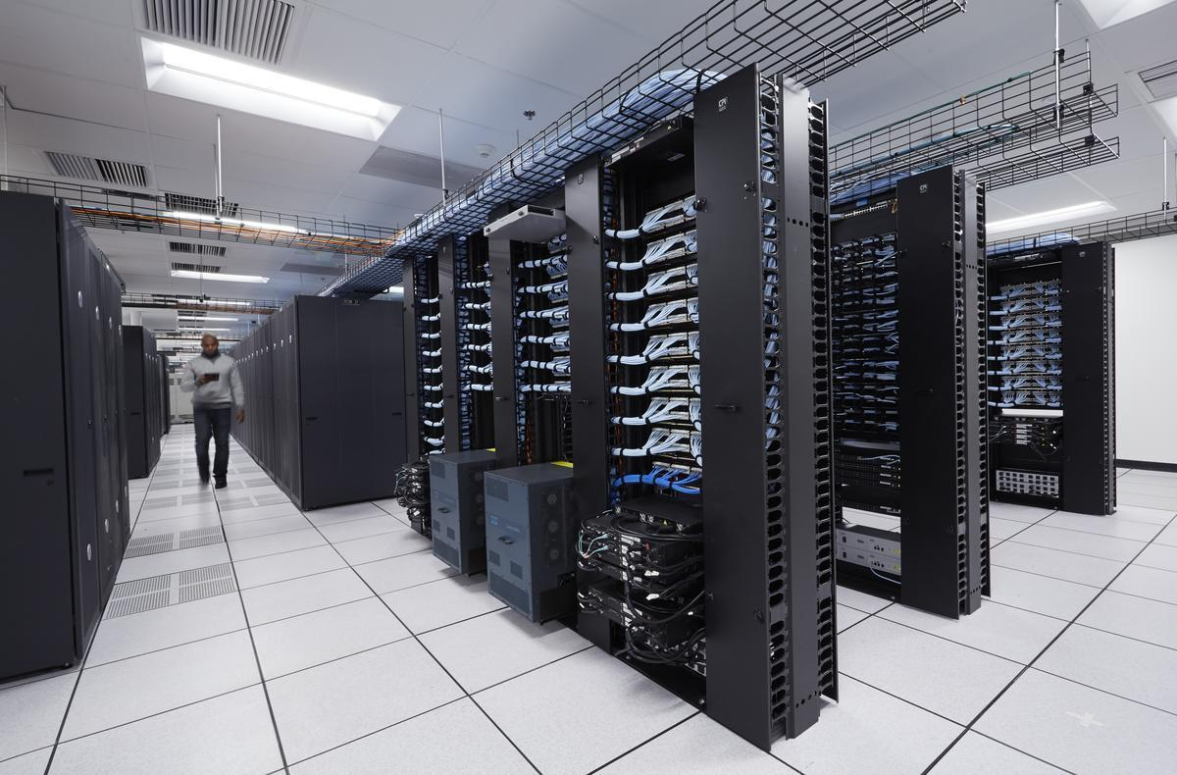
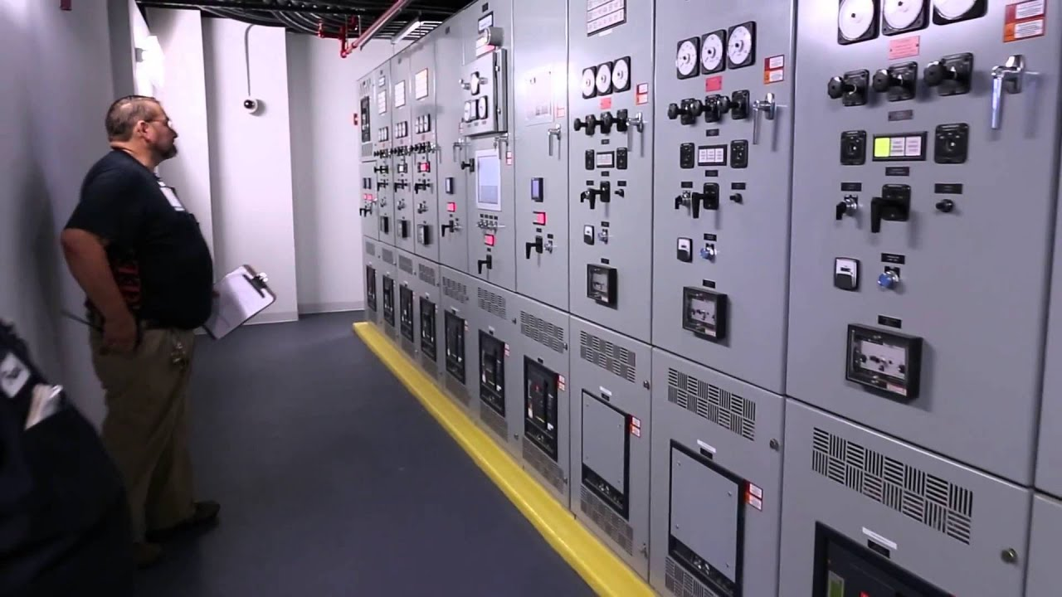
Data Centers
Uninterruptible Power Supply - UPS →

Slide 43
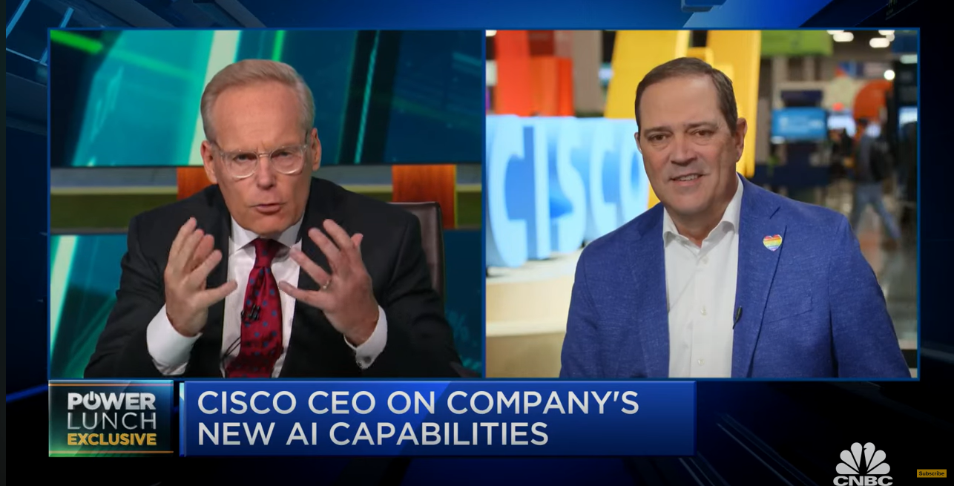

Slide 44

Data Centers Locations
Amazon:
Availability zones - 99
Regions - 31
Current Project - +12 Availability zones

Slide 45









Geographical Data Center Laws
Federal Trade Commission (FTC): In the U.S., the FTC enforces privacy and security laws and regulations, including those related to data security.
International Organization for Standardization (ISO): is an independent, non-governmental international organization that develops standards, including those for data security.
General Data Protection Regulation (GDPR): which is a regulation on data protection and privacy in the European Union and the European Economic Area. It also addresses the transfer of personal data outside these areas.
California Consumer Privacy Act (CCPA): Is an American law that gives consumers more control over the personal information that businesses collect about them, similar to GDPR.
Personal Information Protection and Electronic Documents Act (PIPEDA): Is a Canadian federal law that sets the rules for how businesses must handle personal information during commercial activities.
The Data Protection Act 2018 (DPA 2018): is the UK's implementation of the General Data Protection Regulation (GDPR).
The Information Technology Act, 2000 (IT Act): is an Act of the Indian Parliament notified in October 2000. It is the primary law in India dealing with cybercrime and electronic commerce.
The Protection of Personal Information Act (POPIA): is South Africa's equivalent to the GDPR, setting forth the conditions that establish minimum requirements for the processing of personal information.
General Data Protection Law (LGPD): is A Brazilian general data protection law, similar to the GDPR, which aims to unify the 40 different statutes that currently govern personal data, both online and offline.

Slide 46
Anton Mytnik
Reliability and Performance, Virtual Machines

Slide 47

How is reliability and performance guaranteed?
High Availability
Load Balancing
Scalability
Data Replication
Monitoring and Automation
Notes:
How is reliability and performance guaranteed?
Before we dive deep into how each aspect of reliability and performance in cloud computing works, let's take a look at the bigger picture. How does a cloud computing system guarantee that it's both reliable and performs well? It's a crucial question. After all, in today's digitally-driven world, any downtime or latency can have serious consequences, impacting user experience, productivity, and even revenue.
Cloud computing relies on several key mechanisms working in harmony to create a robust and efficient system. So those key mechanisms are:
High Availability
Load Balancing
Scalability
Data Replication
Monitoring and Automation
And on the next slides, we'll take a closer look at each of these mechanisms, understanding how they function and their role in ensuring reliability and performance in cloud computing.

Slide 48

High Availability
High Availability minimizes downtime for near-continuous access.
Utilizes strategies like replication and redundancy.
Cloud providers distribute data and services globally for resilience.
Automatic failover systems ensure uninterrupted service.
Notes:
High Availability
Let's begin our discussion by focusing on a key aspect of reliability in cloud computing - High Availability. High Availability is a critical design principle that aims to minimize downtime and provide nearly continuous access to services.
The question is - how is this achieved? There are two primary strategies that cloud service providers employ - replication and redundancy.
Replication involves creating multiple instances of data or services. This ensures that even if one instance fails, others are still available to keep the service running. Redundancy, on the other hand, involves provisioning extra resources as backup.
But these strategies are not limited to a single data center or location. Cloud providers distribute data and services across multiple geographic regions around the world. This approach is known as geographic distribution, and it ensures resilience against localized failures or disasters.
And, cloud providers utilize automatic failover systems. These systems are designed to detect failures in servers and reroute user requests to functioning servers. This happens seamlessly, without noticeable disruption to the user.
So, through strategies such as replication, redundancy, geographic distribution, and automatic failover, High Availability ensures that cloud services remain accessible and reliable, contributing significantly to the overall user experience.

Slide 49

Load Balancing
Load Balancing ensures equal distribution of network traffic.
Prevents overloading and ensures smooth performance.
Key for managing user requests efficiently.
Supports scalability by handling increased loads.
Notes:
Load Balancing
The next important aspect of performance and reliability in cloud computing is Load Balancing.
Load balancing is the act of distributing workloads and network traffic across multiple servers to ensure none of them are overloaded, which in turn, ensures smoother and more efficient performance.
So why is Load Balancing critical? Answer is simple. When a single server is overwhelmed with too many requests, the result is often slow response times or even server crashes. To prevent this from happening, load balancers exist. These devices distribute incoming network traffic across a group of backend servers, also known as a server farm or server pool.
This distribution helps ensure that no single server bears too much demand. By spreading the requests evenly, load balancing allows all servers to operate at an optimal level, resulting in faster, more responsive applications.

Slide 50

Scalability
Scalability allows for resource adjustment based on demand.
Key for cost-efficiency and managing high-traffic periods.
Achieved via vertical (more powerful resources) and horizontal (more instances of resources) scaling.
Cloud computing makes scalability easy and fast.
Notes:
Scalability
The next thing that guarantees reliability and performance, is Scalability. Scalability is the ability of a system to easily expand (or contract) its resources to meet changes in demand.
In a traditional computing setup, scalability often involves purchasing and installing new hardware, a time-consuming and costly process. In contrast, cloud computing makes scalability a matter of a few clicks. This is one of the reasons why many businesses are migrating to the cloud.
Scalability comes in two forms - vertical and horizontal. Vertical scaling involves adding more power to an existing machine, such as increasing the CPU power, RAM, or disk capacity. When horizontal scaling involves adding more machines to the system.
So, the cloud's scalability helps businesses manage their resources efficiently, ensuring they can provide a consistent user experience even during high-traffic periods. This ease of scalability is a key contributor to the performance and reliability of cloud services.

Slide 51

Data Replication
Multiple copies of data for protection and availability.
Data stored in different locations for disaster recovery.
Ensures fast recovery in case of system failure.
Essential for data loss prevention and maintaining service continuity.
Notes:
Data Replication
Another important aspect of cloud computing's reliability and performance is Data Replication. Data replication involves creating and maintaining multiple copies of data.
To prevent data loss and maintain service continuity, cloud providers replicate data across different servers and locations, soIf data on one server is lost due to hardware failure, cyberattack, or any other unforeseen event, the system can retrieve a replicated copy from another server, ensuring no disruption to services.
So, data replication ensures fast recovery in case of a system failure. Instead of having to restore vast amounts of data from a backup, which can be time-consuming, the system can quickly switch to using the replicated data, drastically reducing downtime.

Slide 52

Monitoring and Automation
Real-time monitoring for identifying potential issues.
Automation for quick resolution, often before users notice.
AI and machine learning driving more sophisticated monitoring.
Proactive maintenance and problem resolution for high reliability.
Notes:
Monitoring and Automation
And the last two things are Monitoring And Automation. Cloud providers continuously monitor their systems in real time, tracking everything from server load to network performance. This allows them to identify and address potential issues before they escalate into serious problems that could affect performance or cause downtime.
However, with the scale and complexity of cloud environments, manual monitoring isn't enough. This is where automation comes in. With automated processes, cloud providers can respond to potential issues incredibly quickly, often resolving them before users are even aware that there was an issue.
So, monitoring and automation works behind the scenes, anticipating and addressing issues, often before they impact users. This sophisticated system of checks and balances is what makes cloud computing an incredibly reliable and high-performing platform.

Slide 53
How do new virtual machines come into existence?
Resource Allocation
Selecting an Image
Instance Creation
Networking and Security Configuration
Boot Up
Notes:
How do new virtual machines come into existence?
Now let's move on to another topic - the creation of new virtual machines. How these virtual machines, which are such a fundamental part of cloud computing, actually come into existence.
This process is handled by the cloud service providers such as Amazon Web Services, Google Cloud, and Microsoft Azure. These industry giants have vast infrastructures that facilitate the creation of VMs on a large scale. Let's talk about a couple key steps.
Resource Allocation - It all starts with resource allocation. In their extensive data centers, the providers designate a certain amount of server resources, such as processing power, memory, and storage, to each new VM. The goal here is to balance the needs of all the VMs running on their servers, allowing each one to operate efficiently and without interference.
Selecting an Image - The next step involves the user selecting a virtual machine image. This is essentially a template that includes a pre-configured operating system and, often, pre-installed applications. These images can be customized based on the user's requirements, ensuring the VM is fit for its intended purpose.
Instance Creation - Once resources have been allocated and an image has been selected, the cloud service provider's system proceeds to instance creation. The provider's hypervisor, a type of software that creates and manages VMs, initiates a new VM instance with the allocated resources and the chosen image.
Networking and Security Configuration - With the VM instance created, it then needs to be connected to a network. The VM is assigned a network address and is typically placed behind security measures such as firewalls or security groups, safeguarding it from potential threats.
Boot Up - Finally, like any other computer, the VM needs to be booted up. Once this step is completed, it can start running applications and services.
So, that's a brief overview of how new virtual machines come into existence in cloud computing. These VMs, created and managed by the providers, give us the flexibility and scalability that make cloud computing such a powerful tool.

Slide 54

Summary
Cloud Computing
Strengths: Cost Efficiency, Scalability & Flexibility
Challenges: Security and Privacy Concerns
Future Trends: AI Integration, Edge Computing & Sustainable Cloud
Notes:
SUMMARY
Cloud computing has revolutionized the field of IT, enabling businesses of all sizes to leverage vast computing resources on-demand. Its key strengths lie in cost efficiency, scalability, and flexibility. With cloud computing, businesses can scale their IT infrastructure up or down according to their needs, while only paying for what they use.
However, cloud computing is not without its challenges. Security and privacy concerns remain top of mind for many businesses, as sensitive data is stored and processed off-premise. Ensuring robust data protection measures is crucial.
As we look to the future, several exciting trends are emerging. AI and Machine Learning are increasingly integrated with cloud services, driving automation and more sophisticated data analytics. Edge computing is promising to bring data processing closer to the source of data, reducing latency and improving user experiences.
Another interesting aspect is the concept of 'Green Cloud.' As the demand for digital services grows, so does the energy consumption of data centers. Cloud providers are investing in energy-efficient technologies and practices to reduce their environmental impact, paving the way for a more sustainable digital future.
In conclusion, while cloud computing presents its own set of challenges, its potential benefits and future trends offer exciting possibilities for the evolution of our digital world.

Slide 55
Demo/Supporting Materials
Finally, I will guide you through a hands practice on how to create your own free server on the cloud. For this example, we will be using AWS.

Slide 56
Q/A

Slide 57
Citations
Law, Marcus. "Top 10 Biggest Cloud Providers in the World in 2023." Technology Magazine, 15 February 2023, www.technologymagazine.com/top10/top-10-biggest-cloud-providers-in-the-world-in-2023.
Mesbahi, Mohammad Reza, et al. “Reliability and High Availability in Cloud Computing Environments: A Reference Roadmap - Human-Centric Computing and Information Sciences.” SpringerOpen, 6 July 2018, hcis-journal.springeropen.com/articles/10.1186/s13673-018-0143-8.
Runkevicius, Dan. “How Amazon Quietly Powers the Internet.” Forbes, 18 Sept. 2020, www.forbes.com/sites/danrunkevicius/2020/09/03/how-amazon-quietly-powers-the-internet/?sh=6d0b47fa3092.
CNBC Television. "Cisco CEO on Networking Cloud Launch, New A.I. Capabilities and Cybersecurity." YouTube, uploaded on June 6th 2023, www.youtube.com/watch?v=EEQnNGwHjNE.

